Slide 1
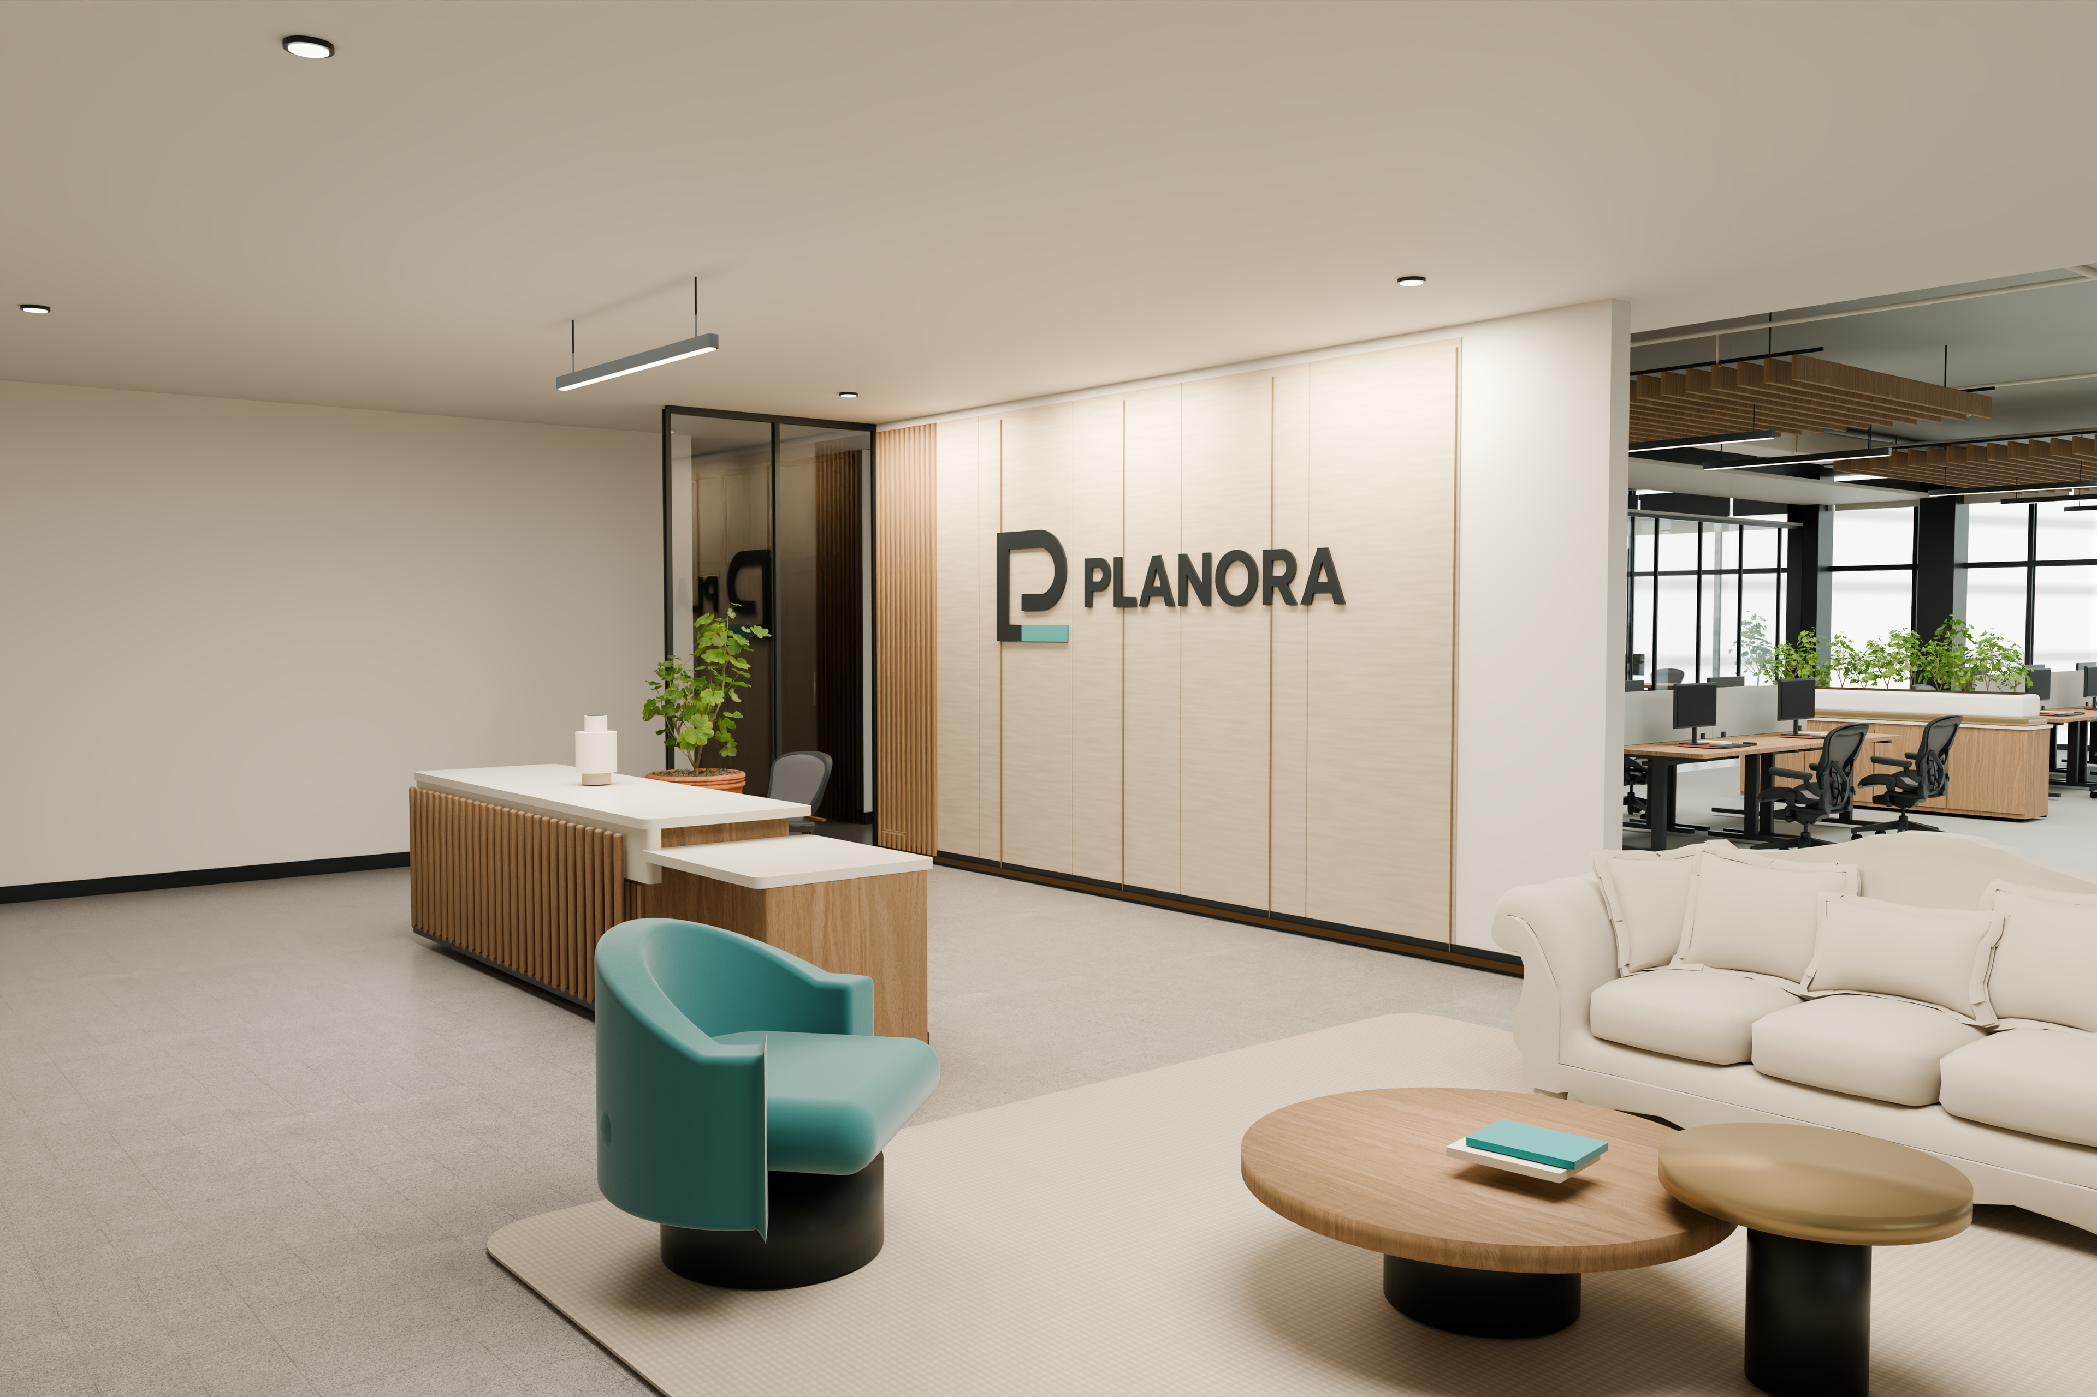
PLANORA / MIAMI OFFICE
PLANORA Presentation
Miami Office
A place to shape what comes next.
Prepared by PLANORA · September 22, 2026
01

Slide 2
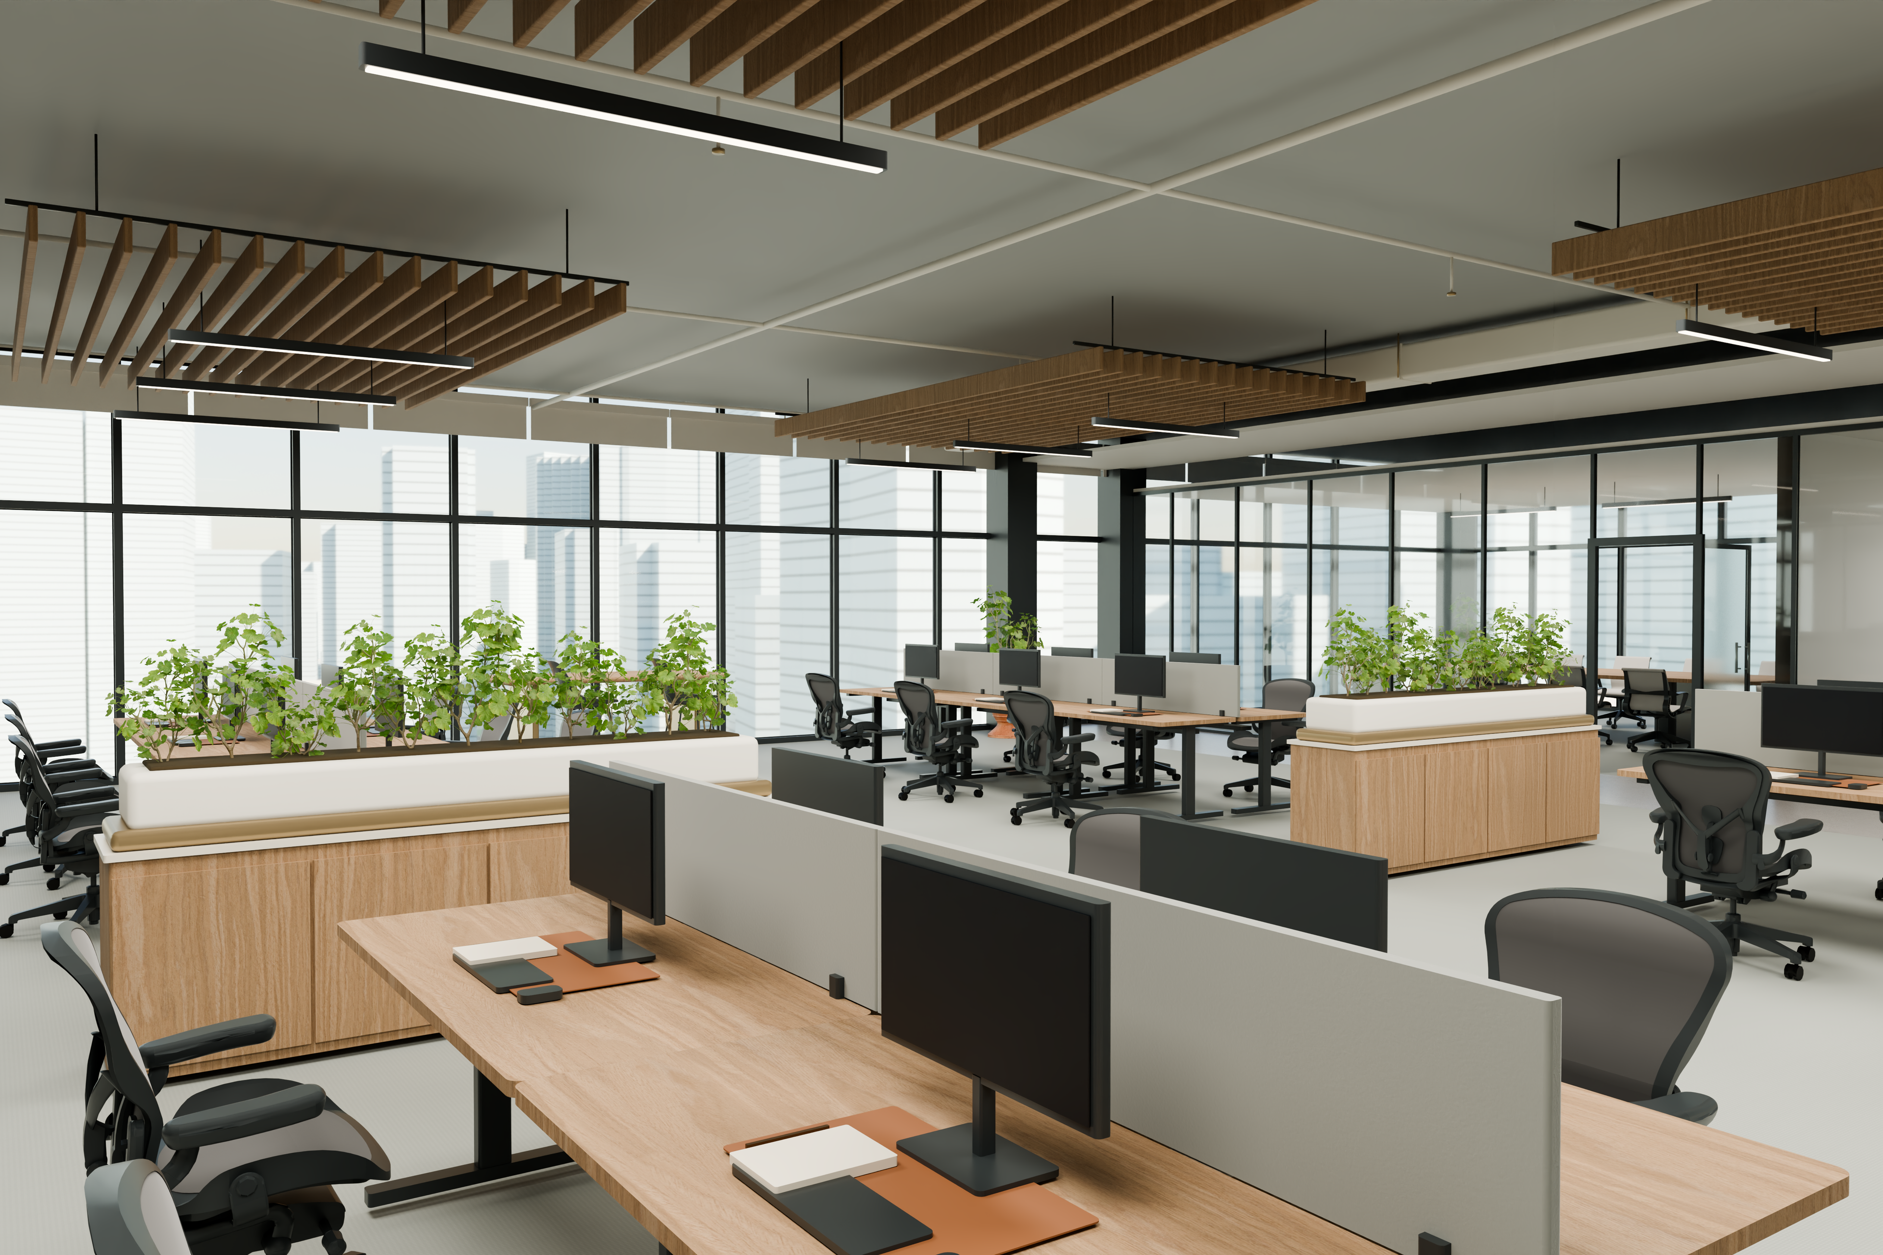
PLANORA / MIAMI OFFICE
Project Overview
8,000 ft² · An illustrative Miami high-floor office
One proposal for working, meeting and welcoming.
Prepared by PLANORA · September 22, 2026
02

Slide 3
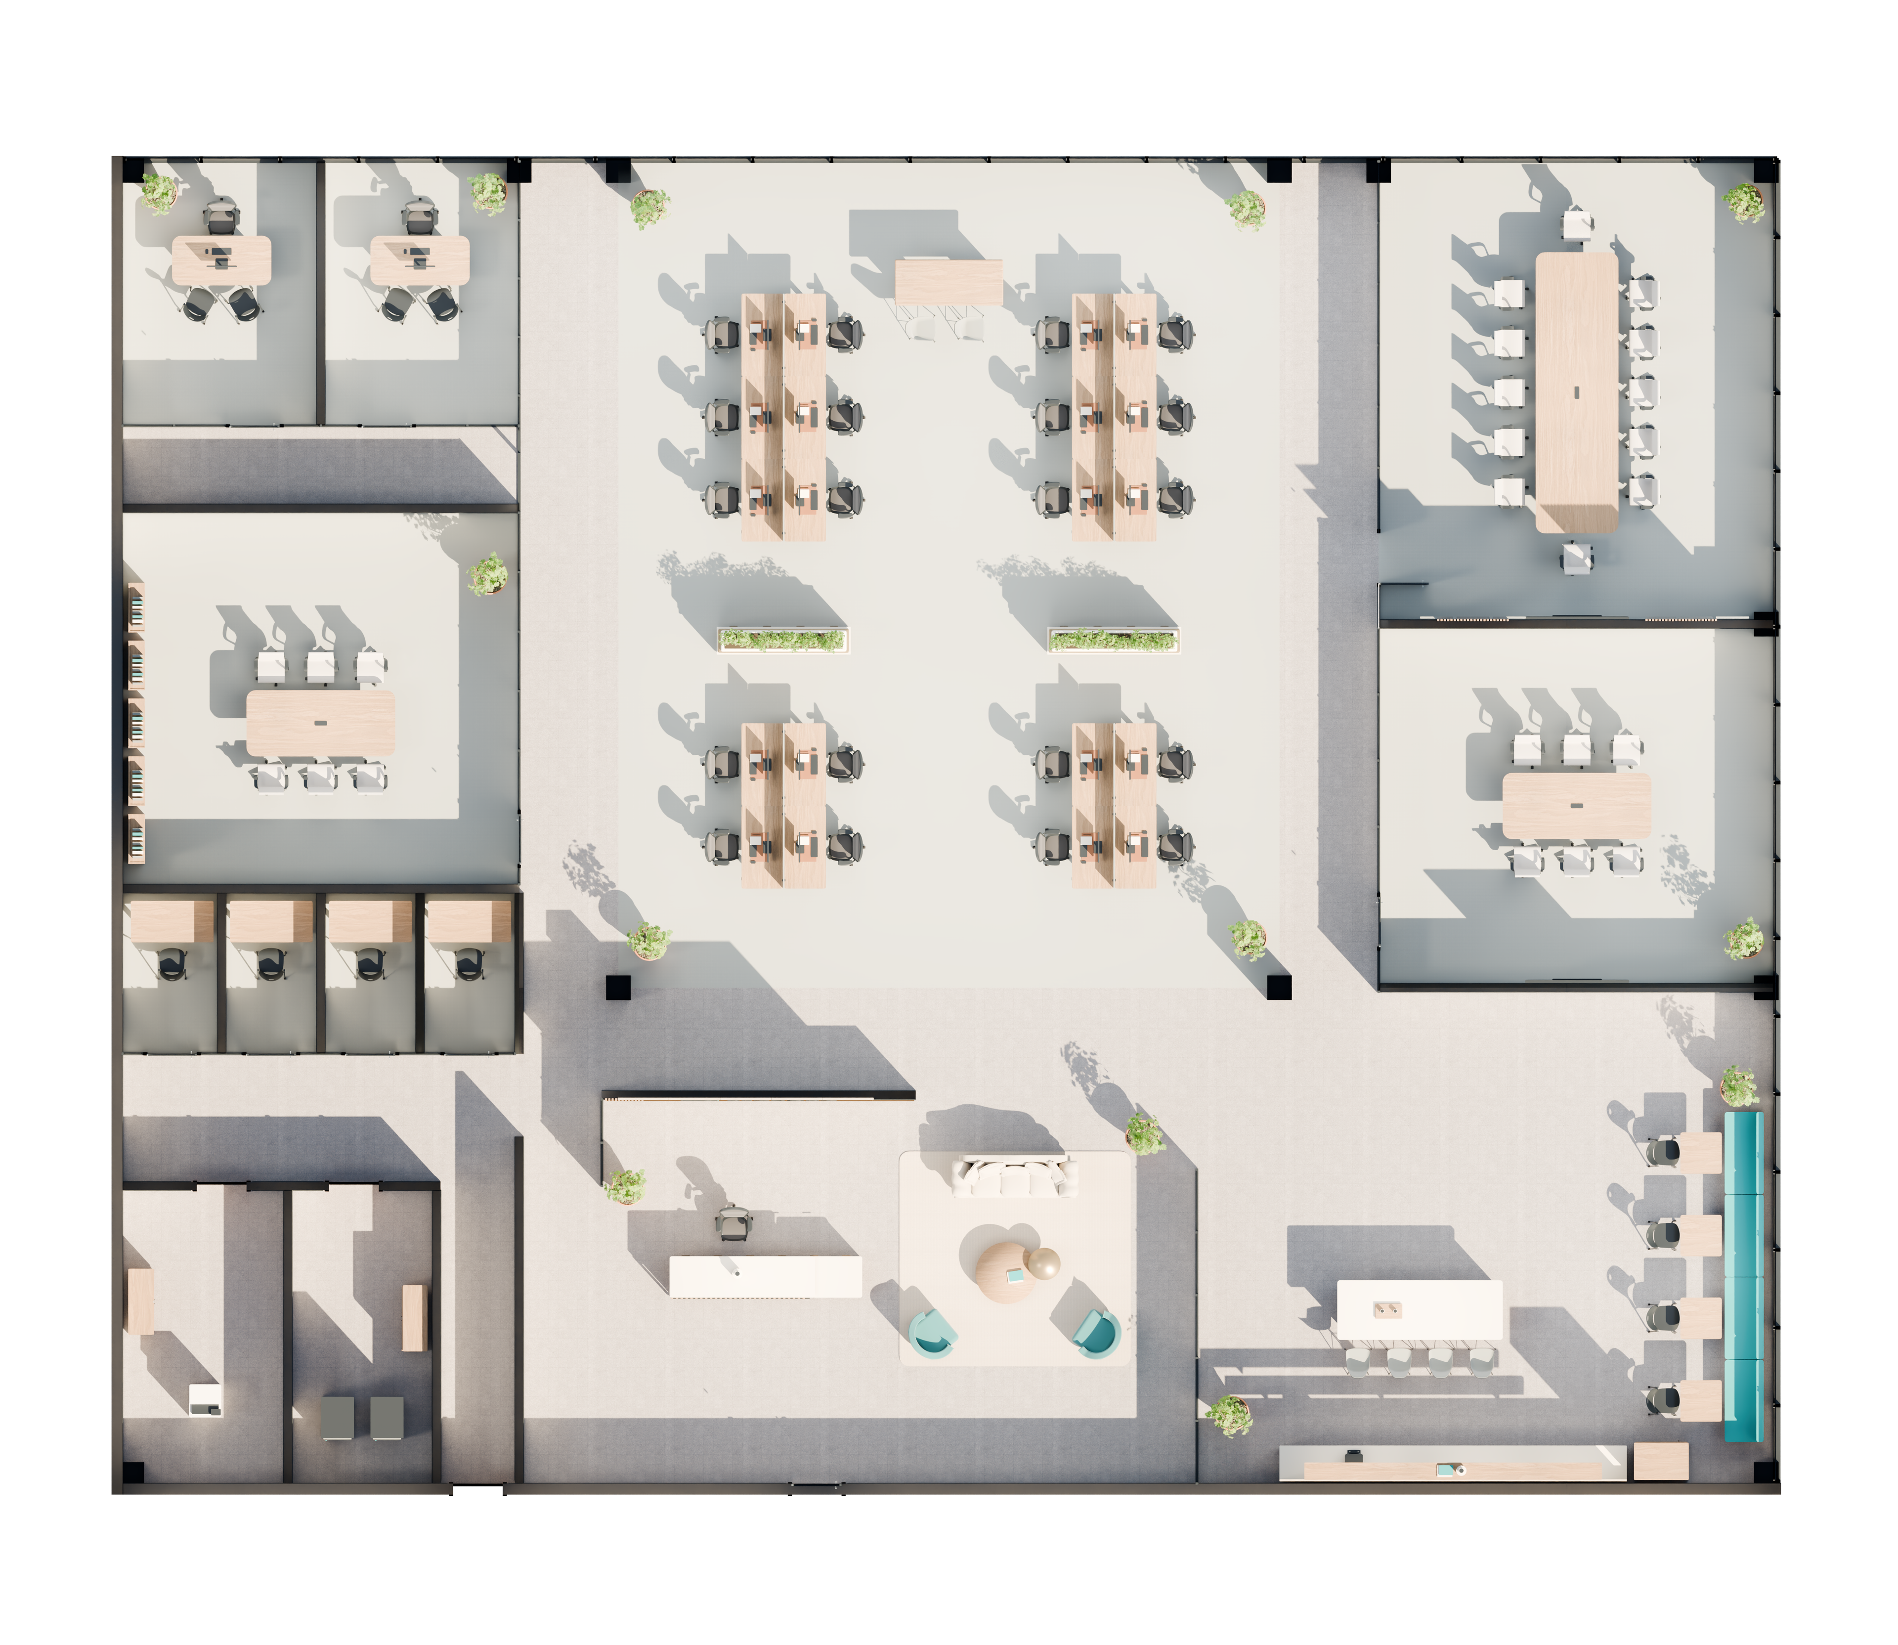
PLANORA / MIAMI OFFICE
Space & Capacity
20 open workpoints + 2 private offices + 1 reception
12-seat boardroom · two 6-seat rooms · four focus rooms
Prepared by PLANORA · September 22, 2026
03

Slide 4
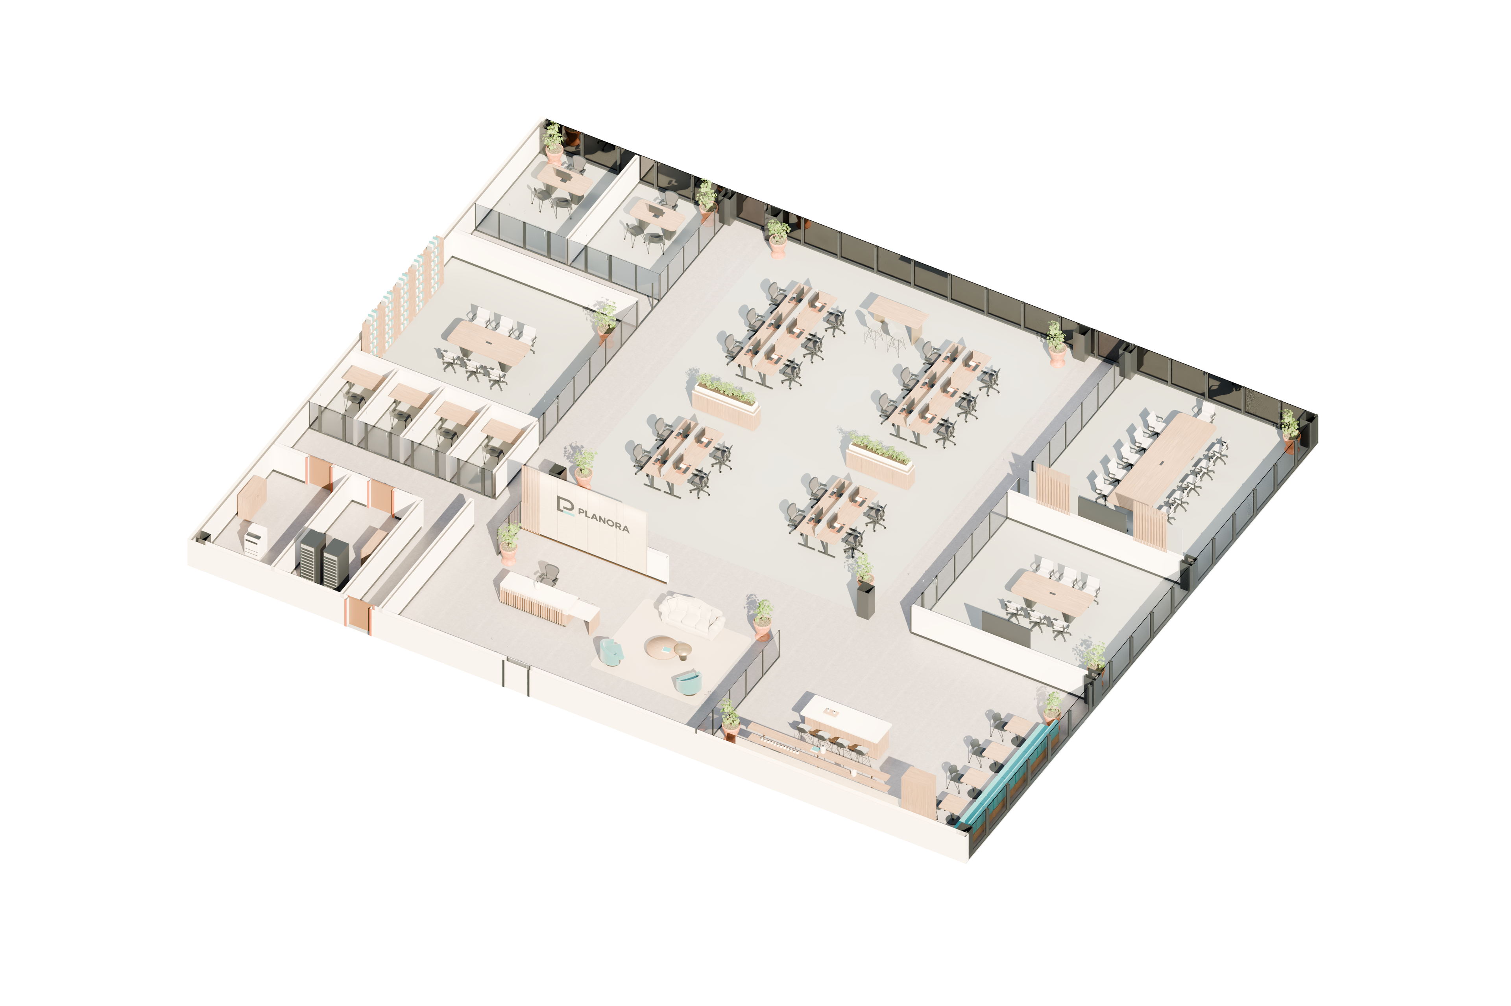
PLANORA / MIAMI OFFICE
Office Layout
A central studio with supporting spaces around it.
Reception and cafe define the arrival setting.
Prepared by PLANORA · September 22, 2026
04

Slide 5
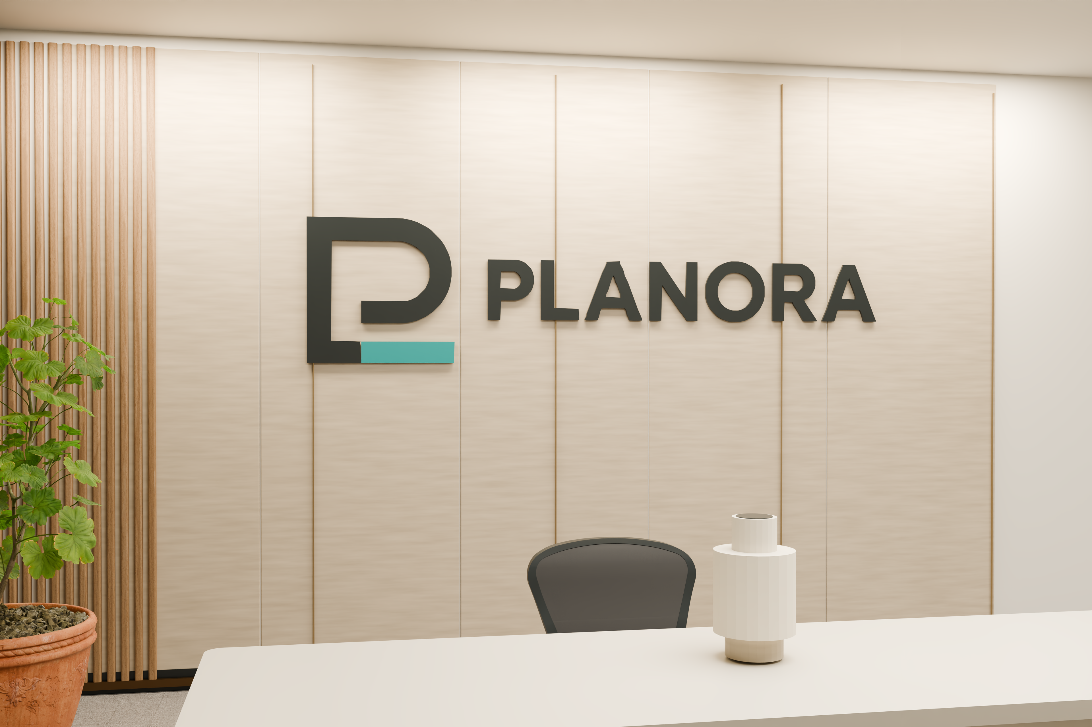
PLANORA / MIAMI OFFICE
Design & Brand
Warm oak · mineral surfaces · charcoal frames
Existing PLANORA identity, expressed with restraint.
Prepared by PLANORA · September 22, 2026
05

Slide 6
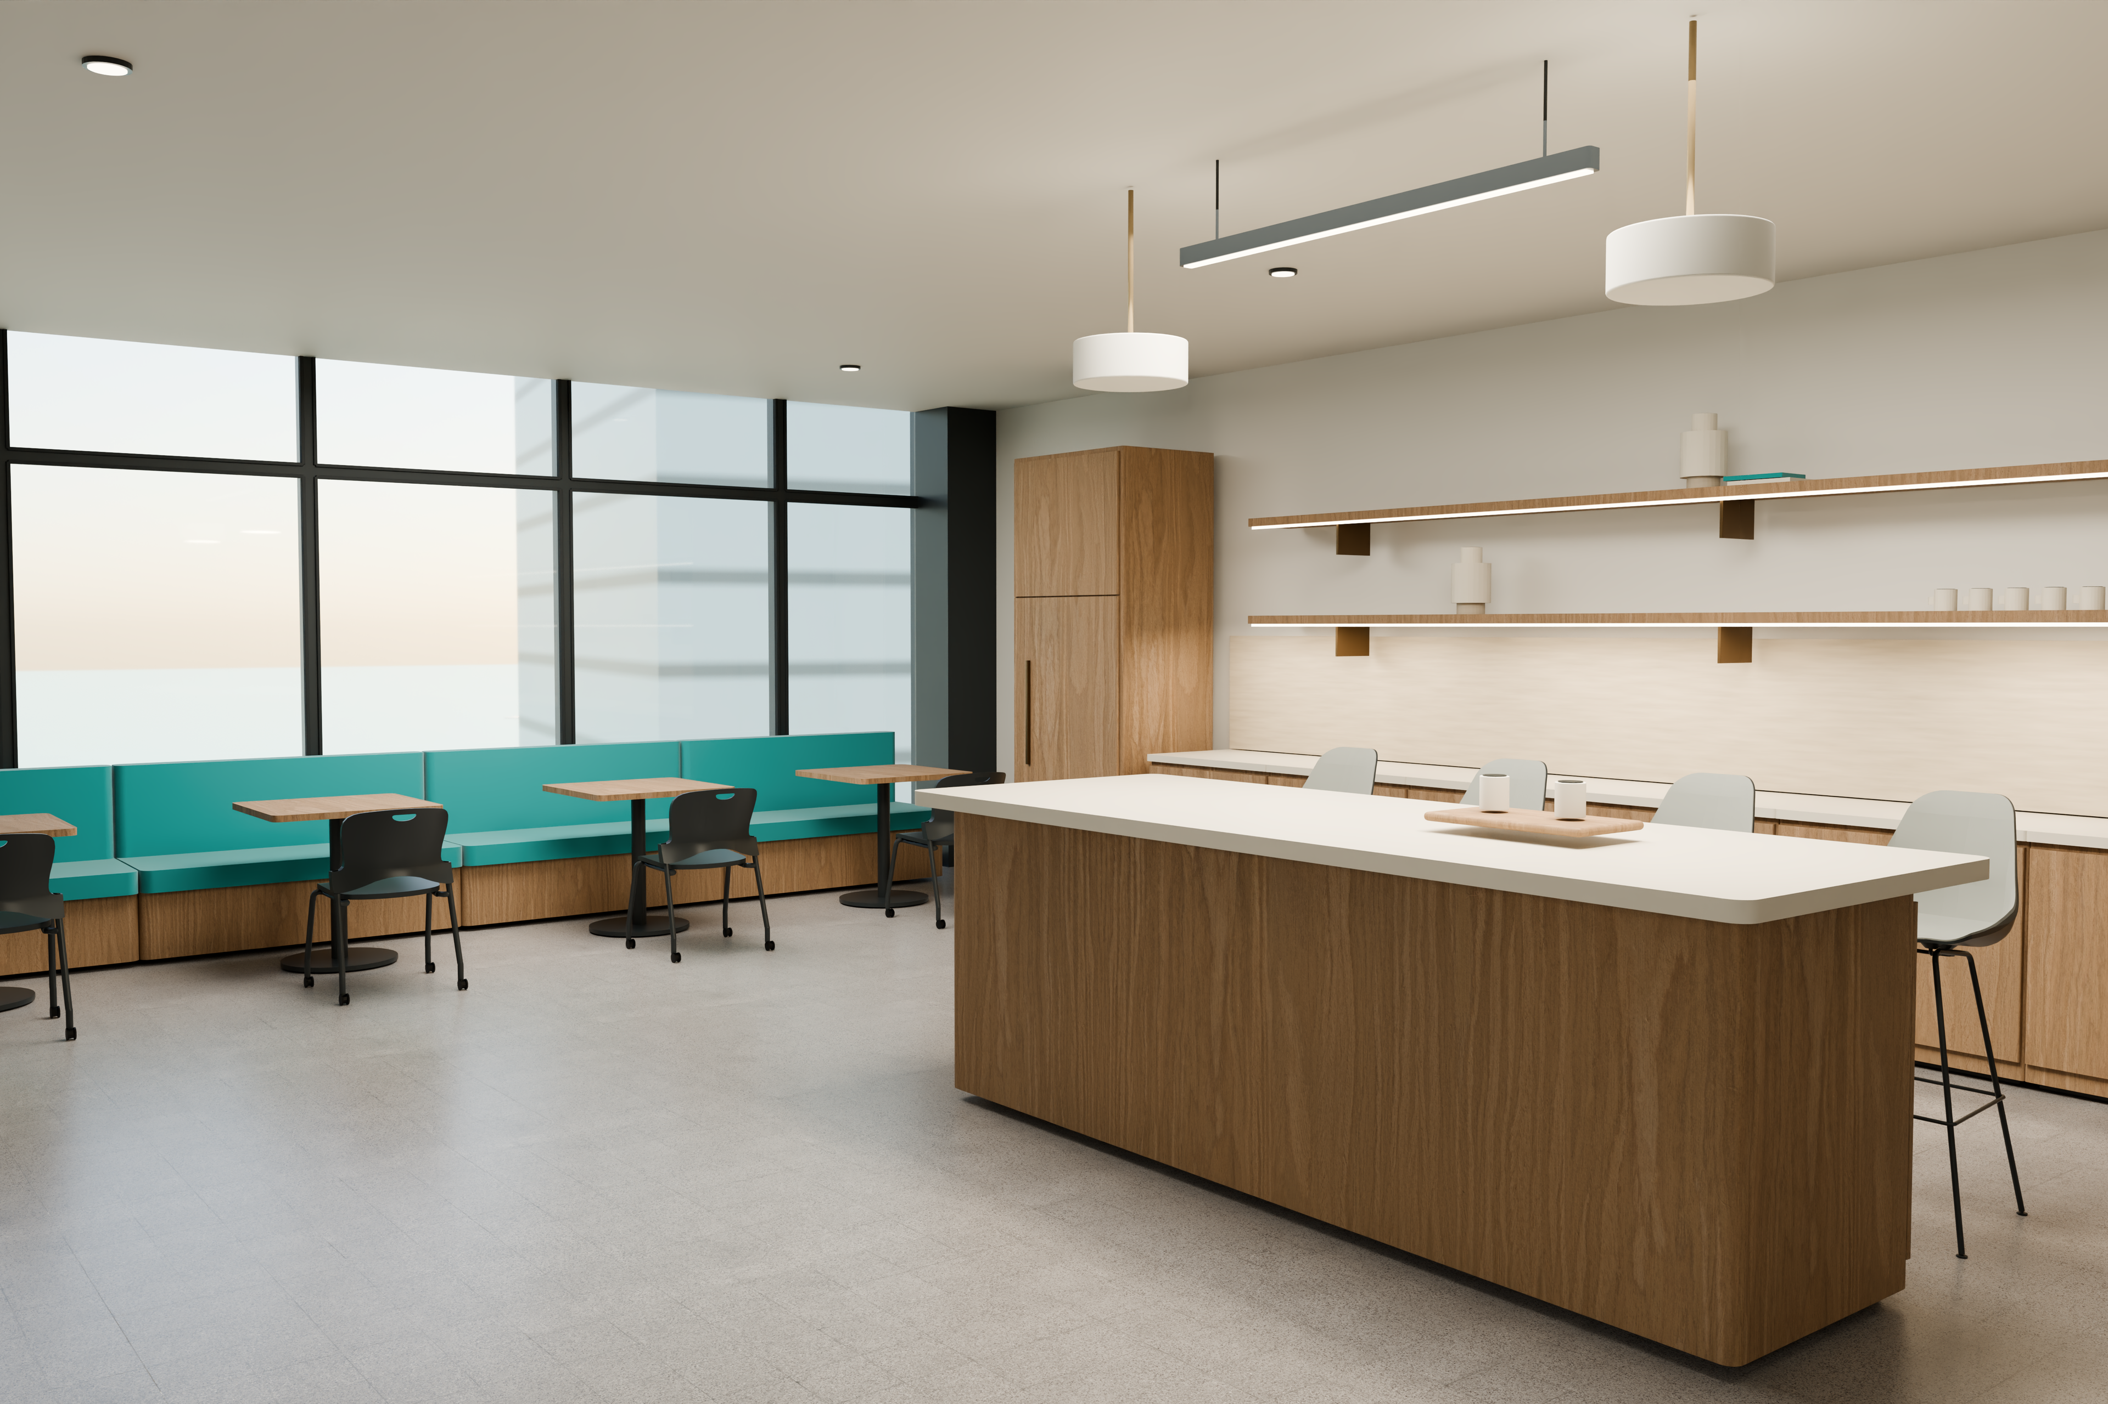
PLANORA / MIAMI OFFICE
Arrival & Hospitality
A confident welcome and a shared place to pause.
Prepared by PLANORA · September 22, 2026
06

Slide 7
PLANORA / MIAMI OFFICE
The Working Studio
Twenty open workstations form the core of the office.
Prepared by PLANORA · September 22, 2026
07

Slide 8
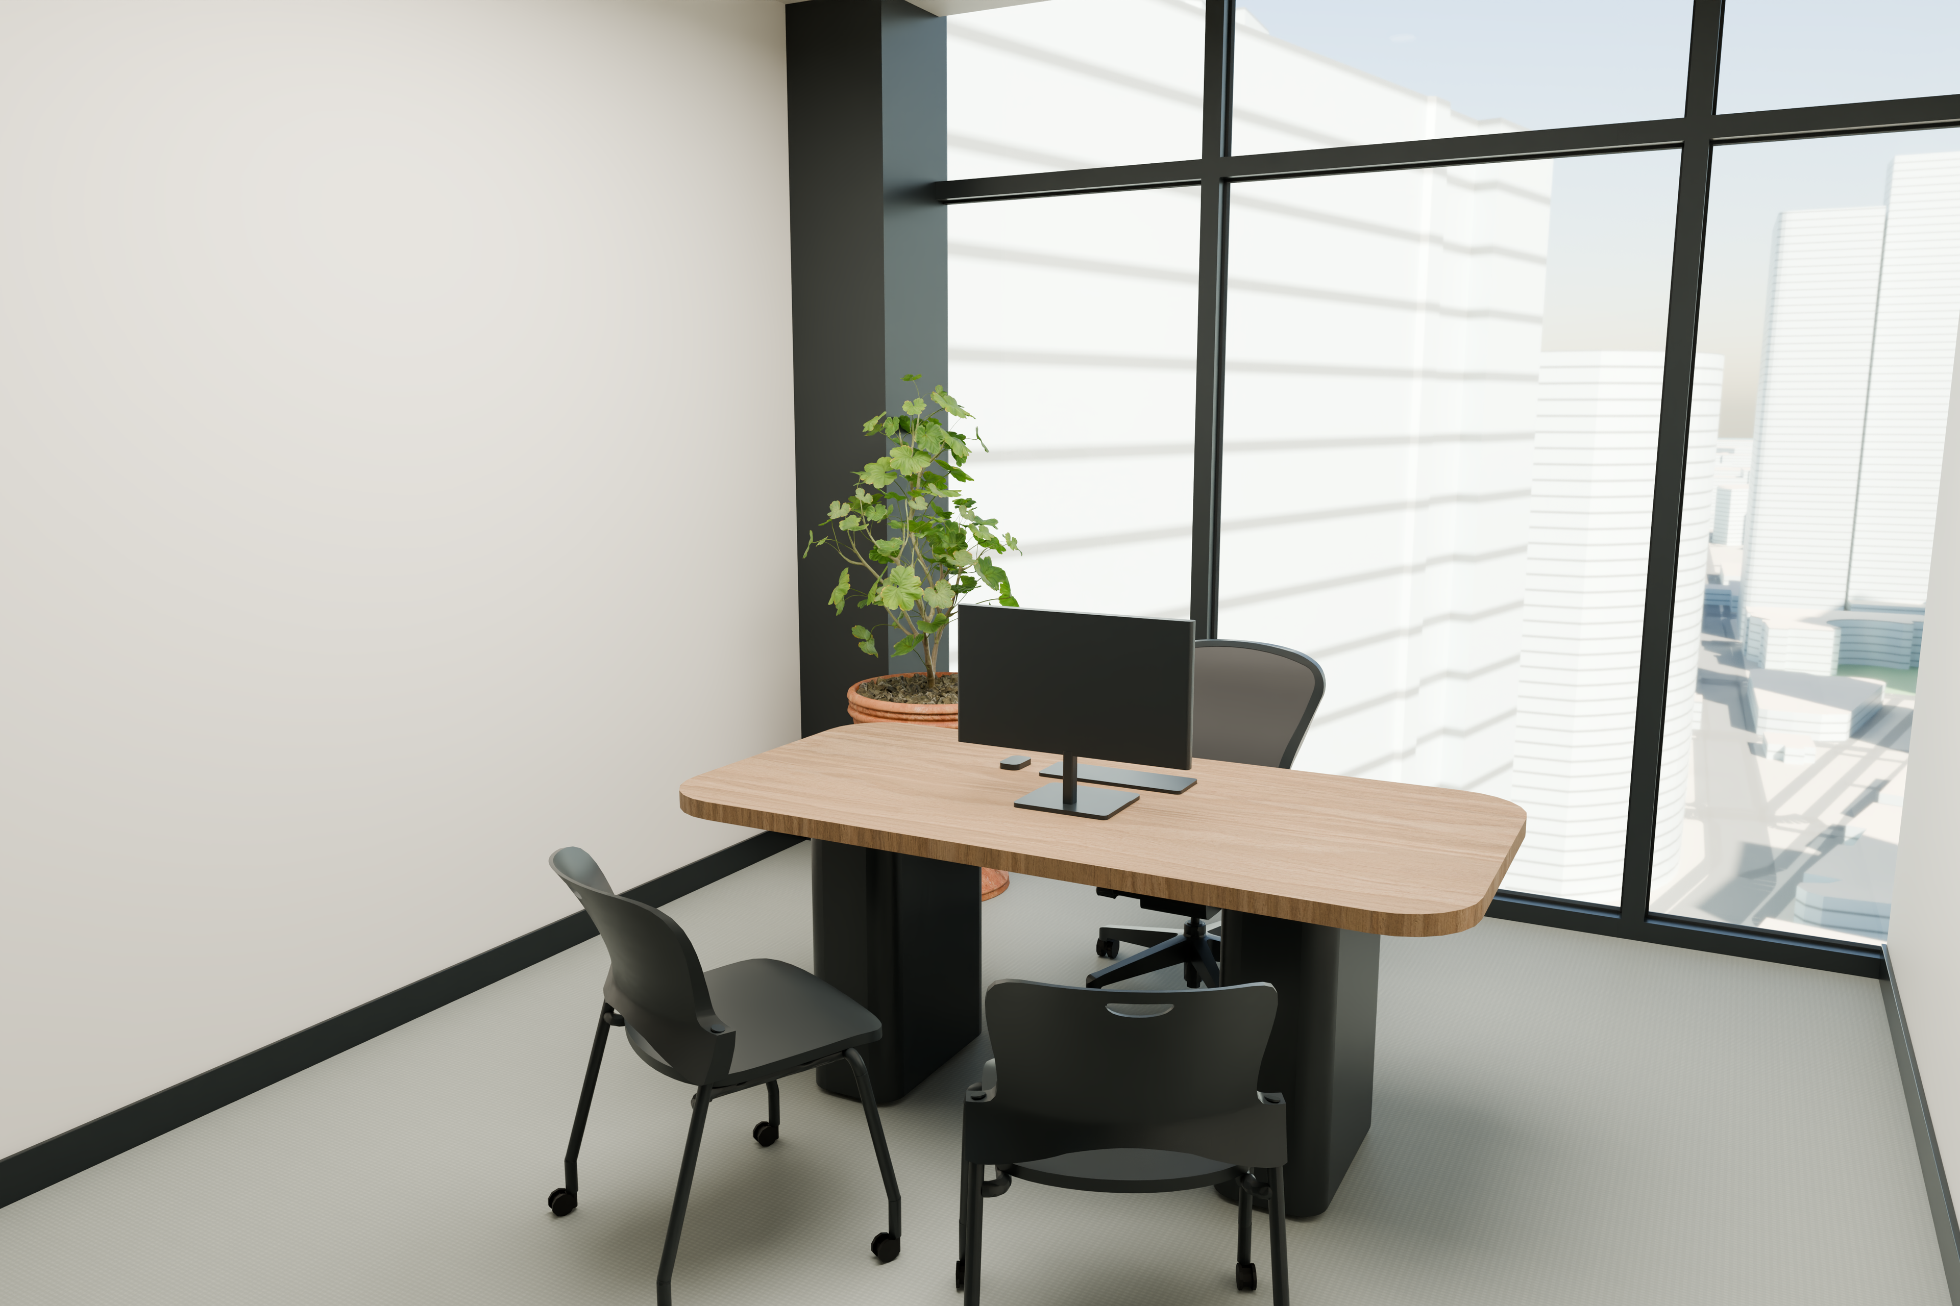
PLANORA / MIAMI OFFICE
A private setting for focused work
An enclosed office combines an assigned desk and visitor seating, with the Miami context beyond the facade.
Prepared by PLANORA · September 22, 2026
08

Slide 9
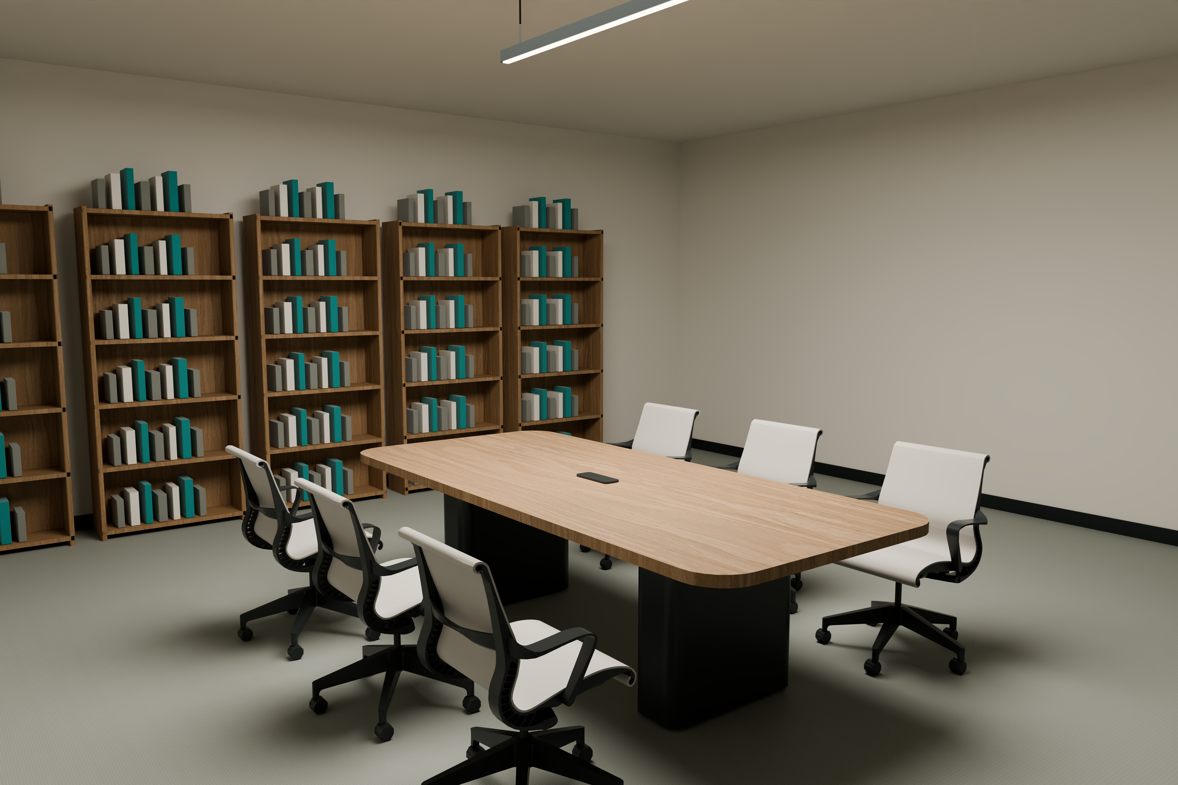
PLANORA / MIAMI OFFICE
A place to develop ideas
Six shared seats support project discussions in an enclosed room, separate from the working studio.
Prepared by PLANORA · September 22, 2026
09

Slide 10
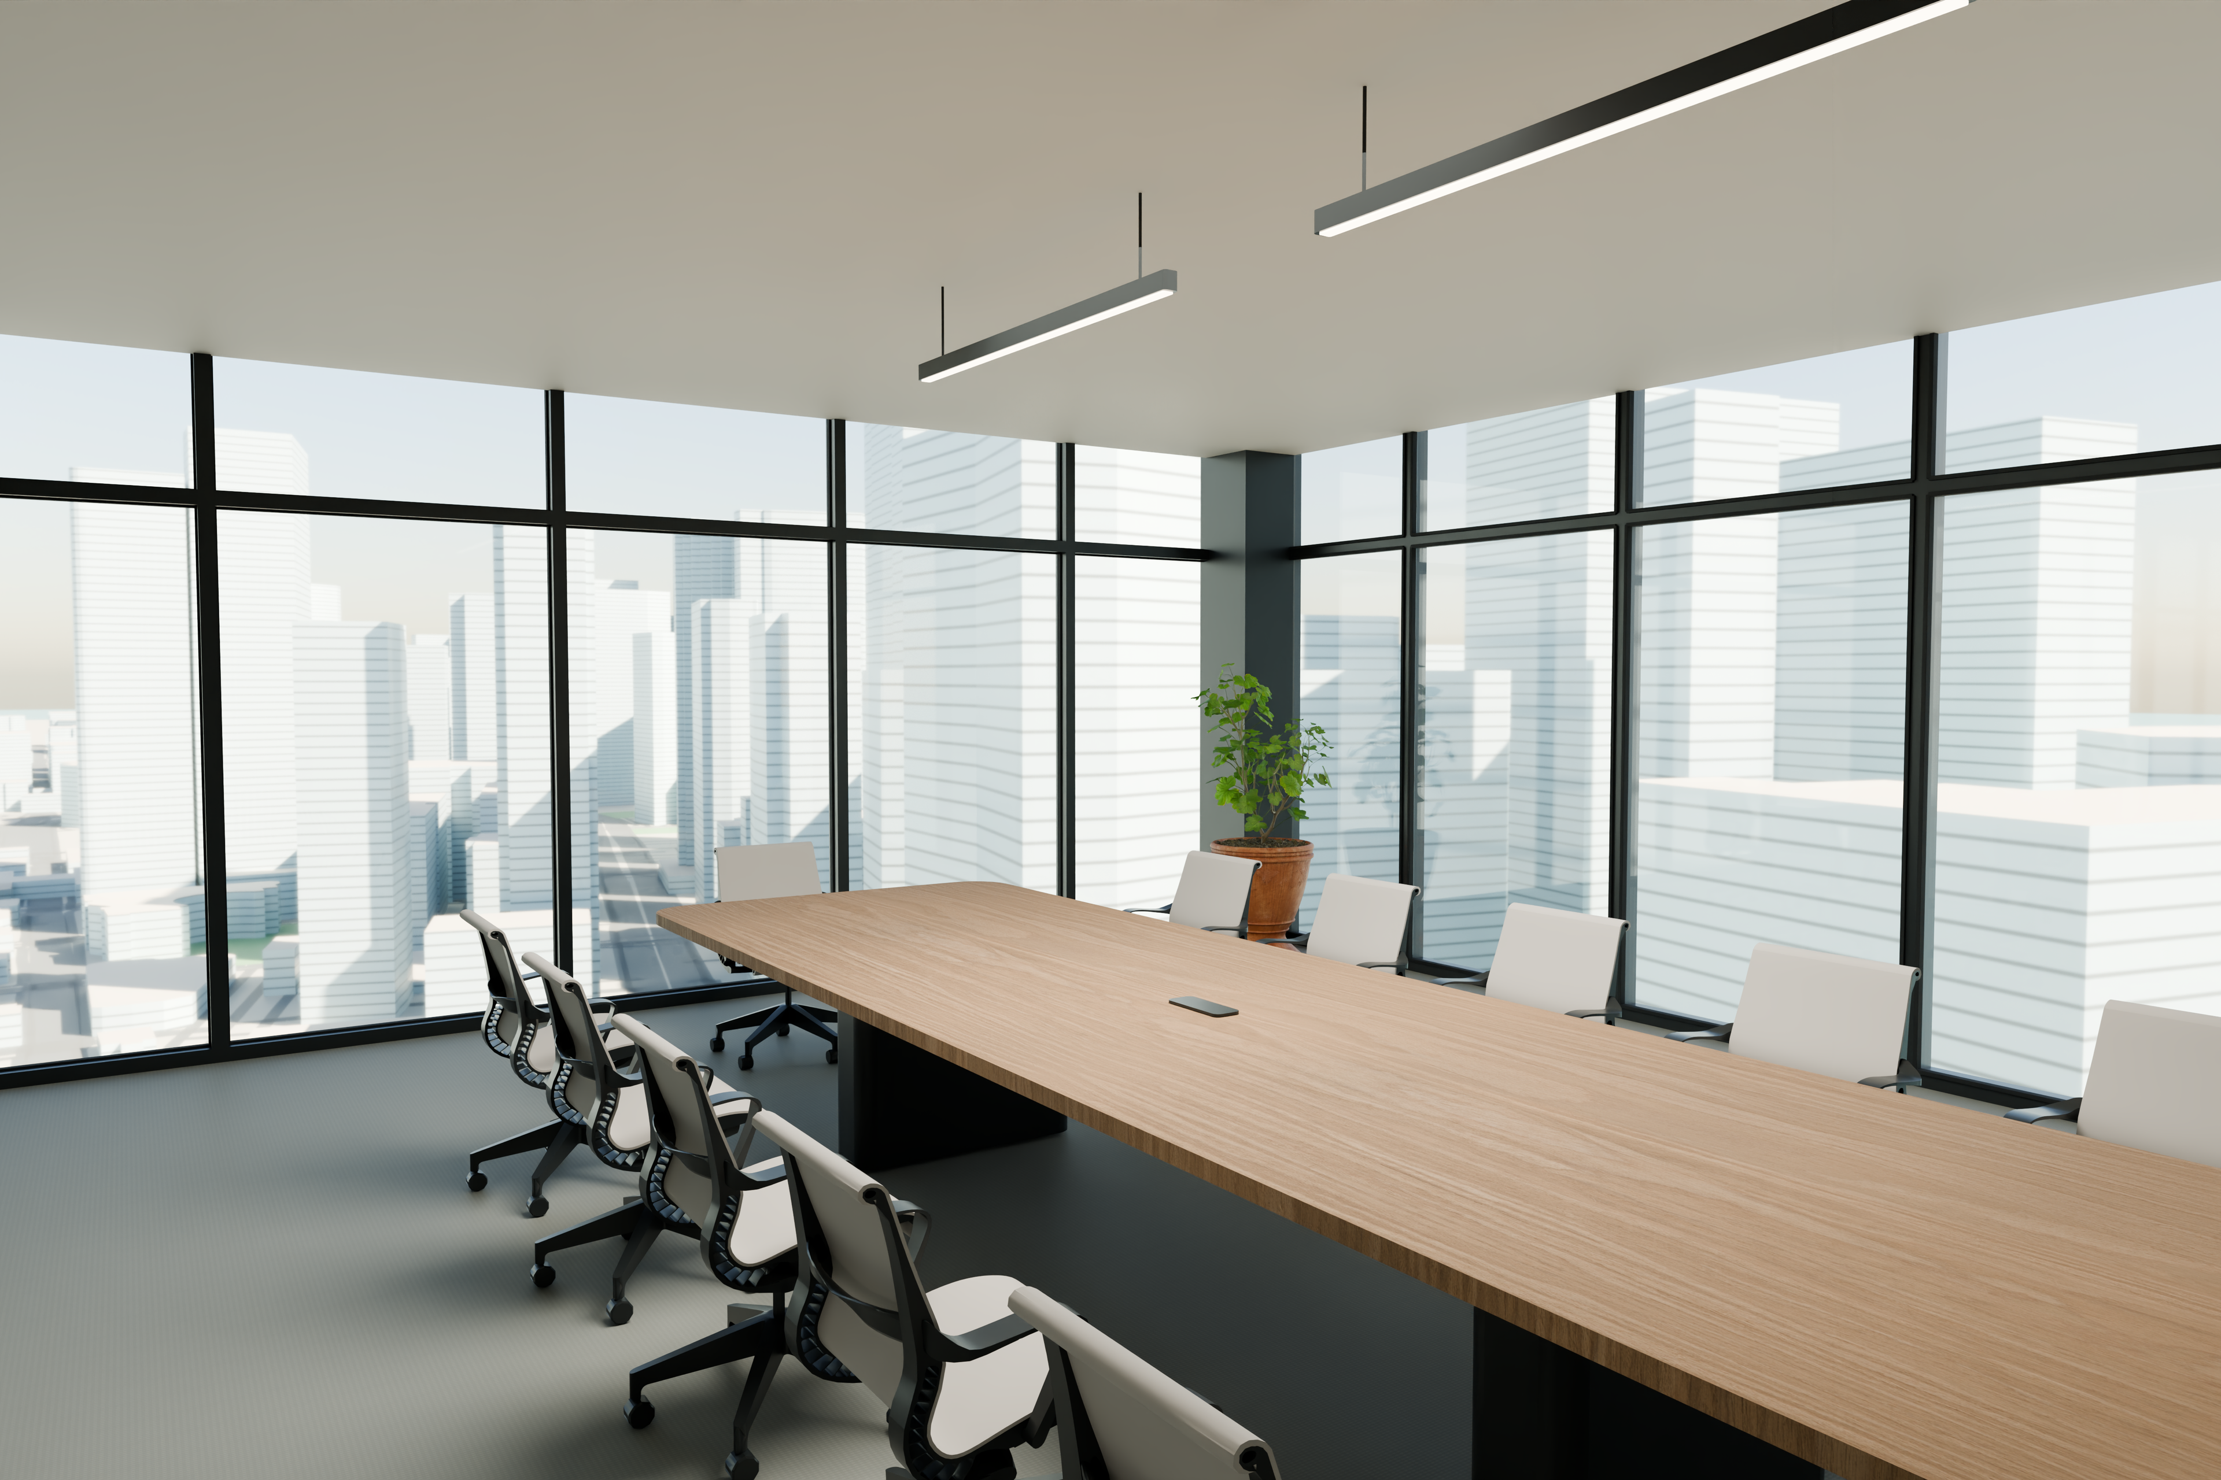
PLANORA / MIAMI OFFICE
The Boardroom
Twelve seats around a shared table.
Prepared by PLANORA · September 22, 2026
10

Slide 11
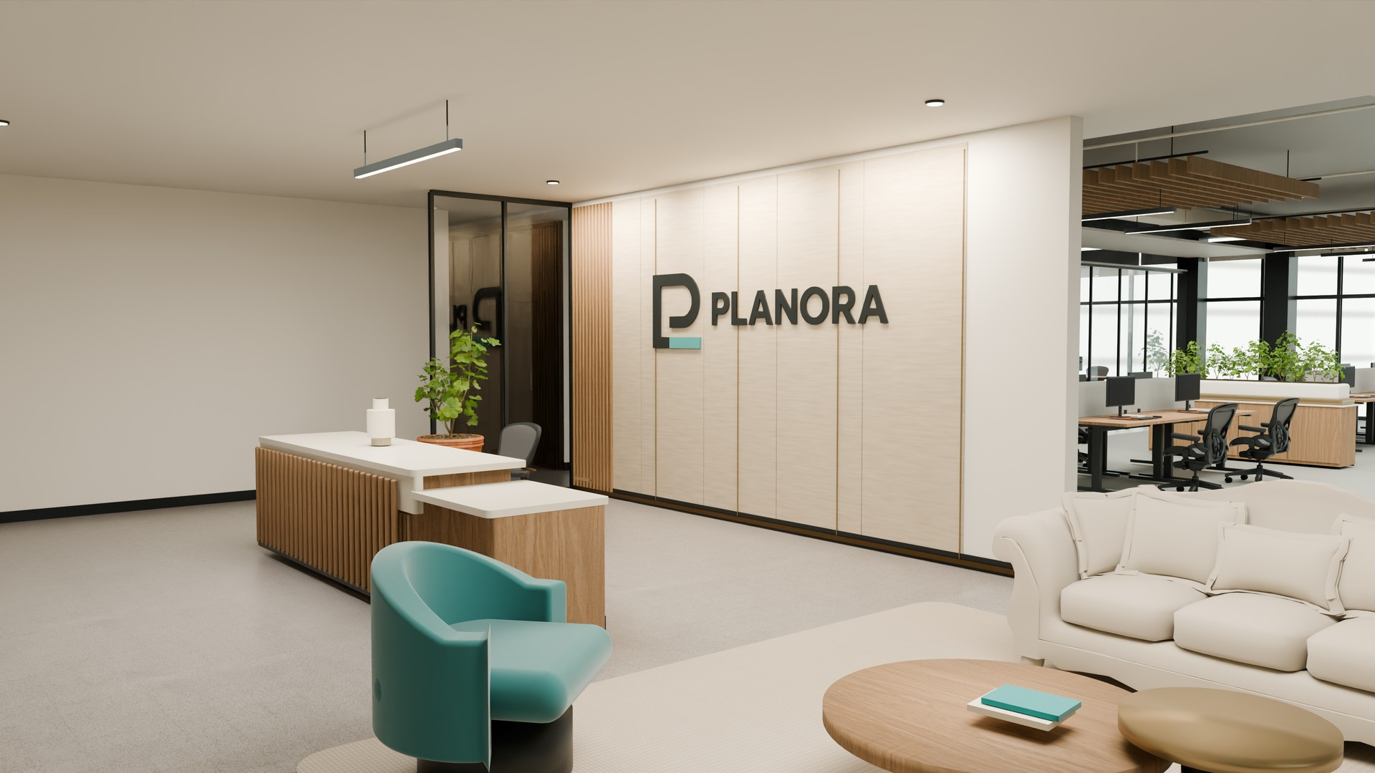
PLANORA / MIAMI OFFICE
Office Film & 3D Portal
Play the embedded 60-second film in PowerPoint slide show.
For the rotatable 3D model, open the delivery portal. PDF: use Office Film.mp4 or the portal.
Prepared by PLANORA · September 22, 2026
11

Slide 12
PLANORA / MIAMI OFFICE
Next Steps
Confirm the premises and operating brief before technical development.
Conceptual demonstration · Not for construction
Prepared by PLANORA · September 22, 2026
12

