Slide 1
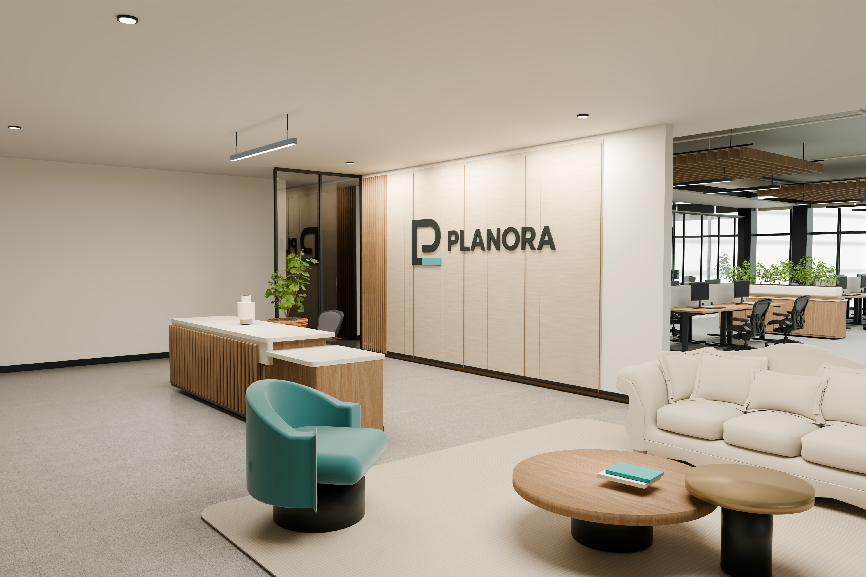
PLANORA / MIAMI OFFICE
PLANORA Decision
Miami Office
A place to shape what comes next.
Prepared by PLANORA · September 22, 2026
01

Slide 2
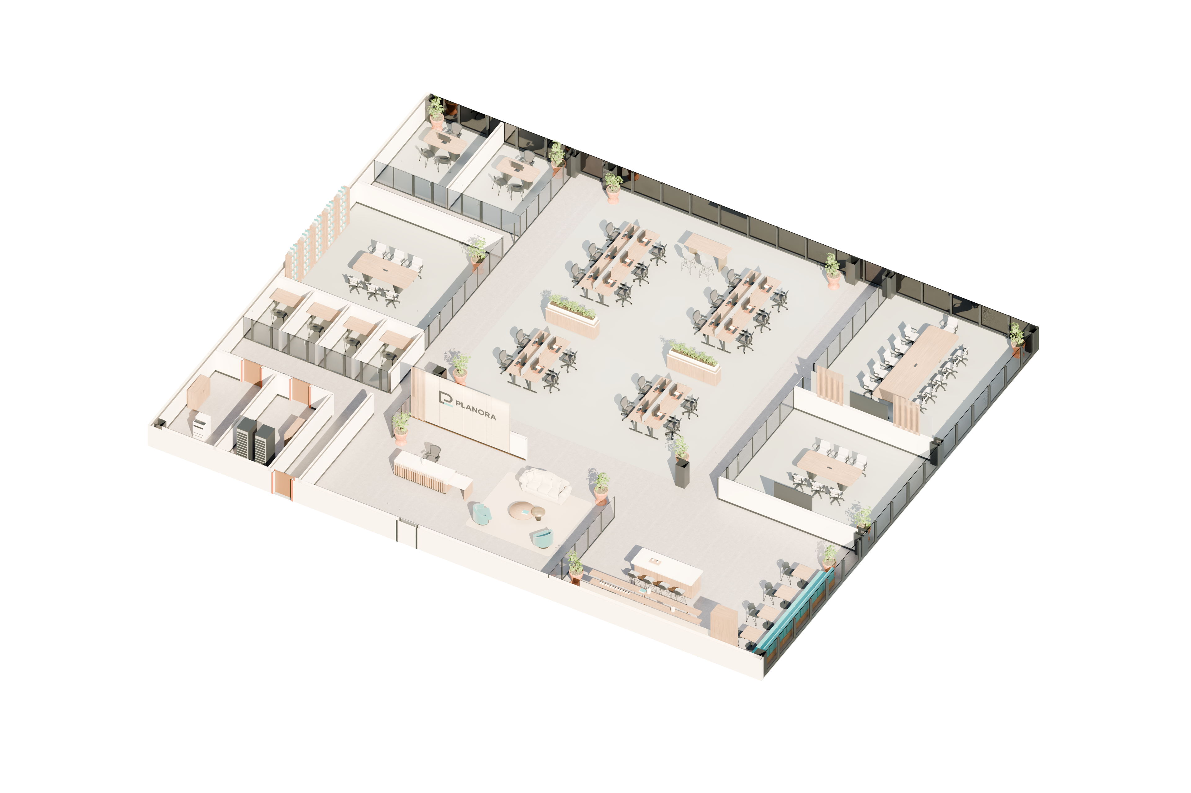
PLANORA / MIAMI OFFICE
Decision at a Glance
22 staff workpoints + reception
~$1.74m base investment · ~36.9 weeks total
Conditional on premises, brief and technical validation.
Prepared by PLANORA · September 22, 2026
02

Slide 3
PLANORA / Miami Office
Demonstration Brief
Synthetic assumptions used to evaluate this existing design.
DAY ONE
PLANNING HORIZON
PRIORITY
22 staff + reception
3 years · stable attendance
Hospitality + project collaboration
No extra growth desks. No client budget ceiling supplied.
Validate actual headcount, meeting demand, premises and technical capacity before commitment. This is not a real client instruction or approval.
Prepared by PLANORA · September 22, 2026
03

Slide 4
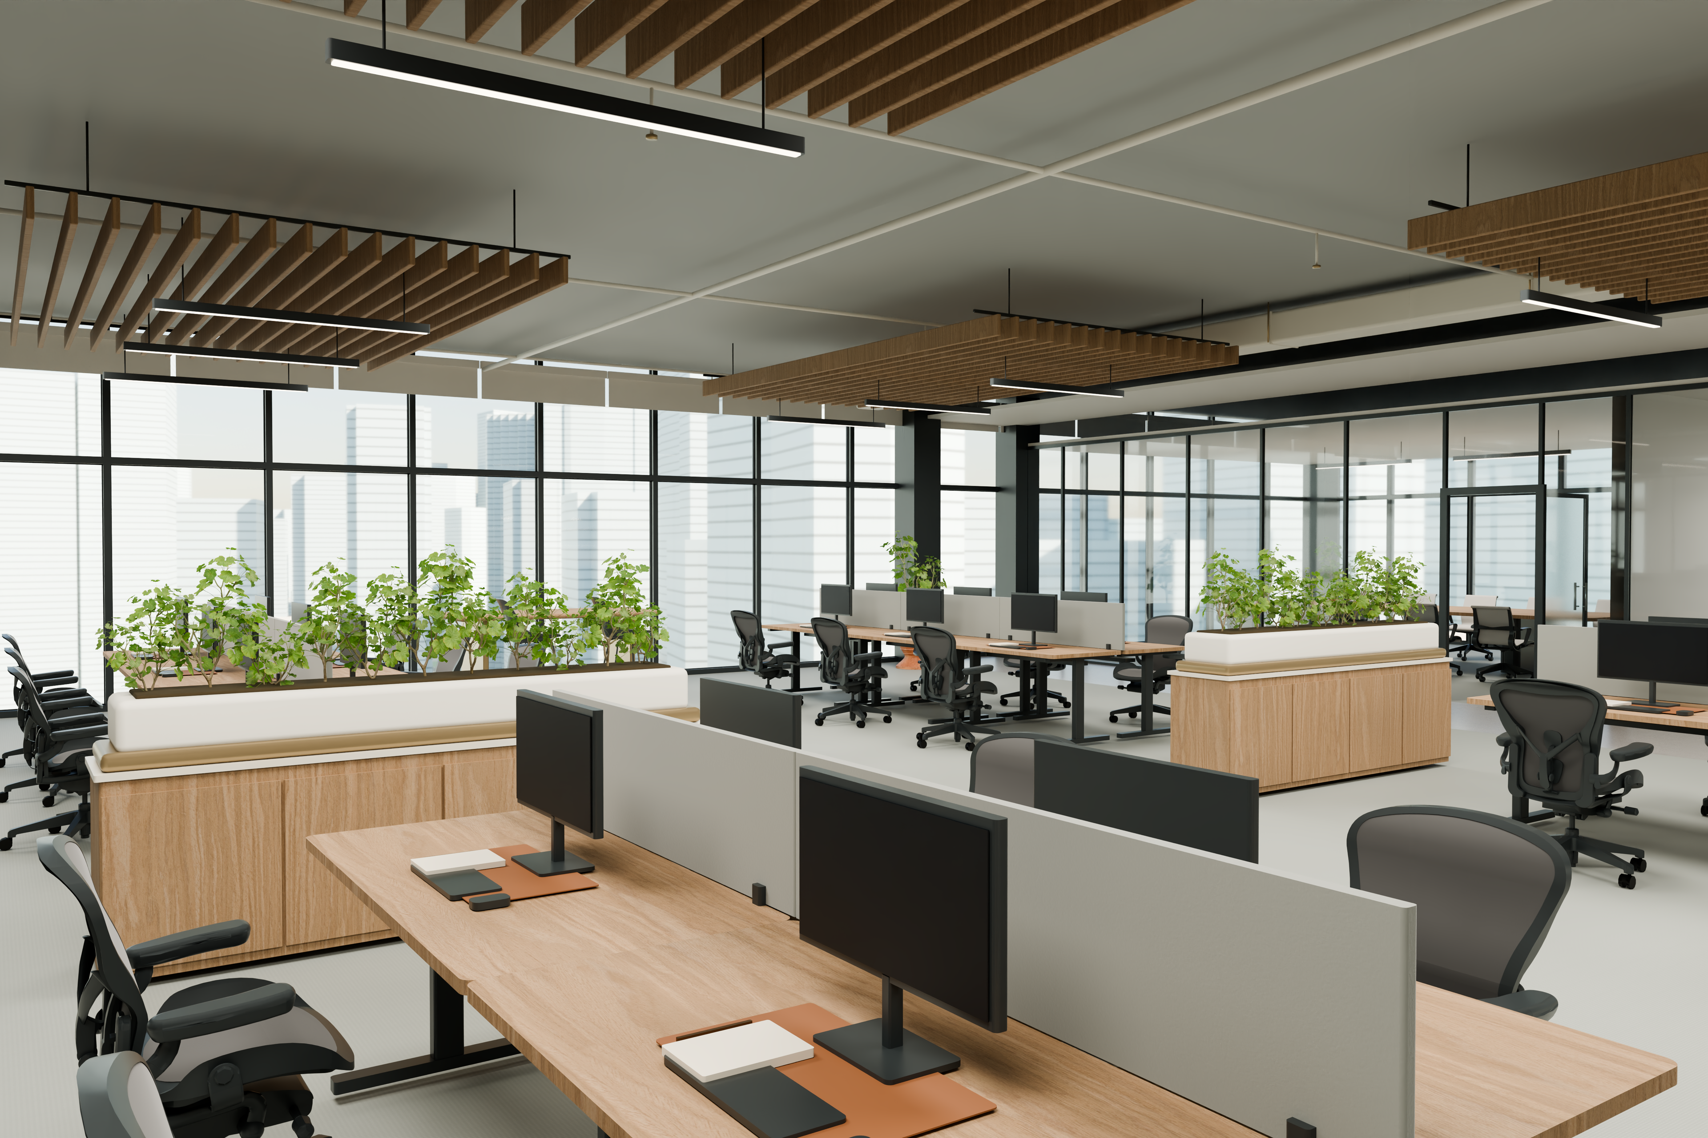
PLANORA / MIAMI OFFICE
Project Overview
8,000 ft² · An illustrative Miami high-floor office
One proposal for working, meeting and welcoming.
Prepared by PLANORA · September 22, 2026
04

Slide 5
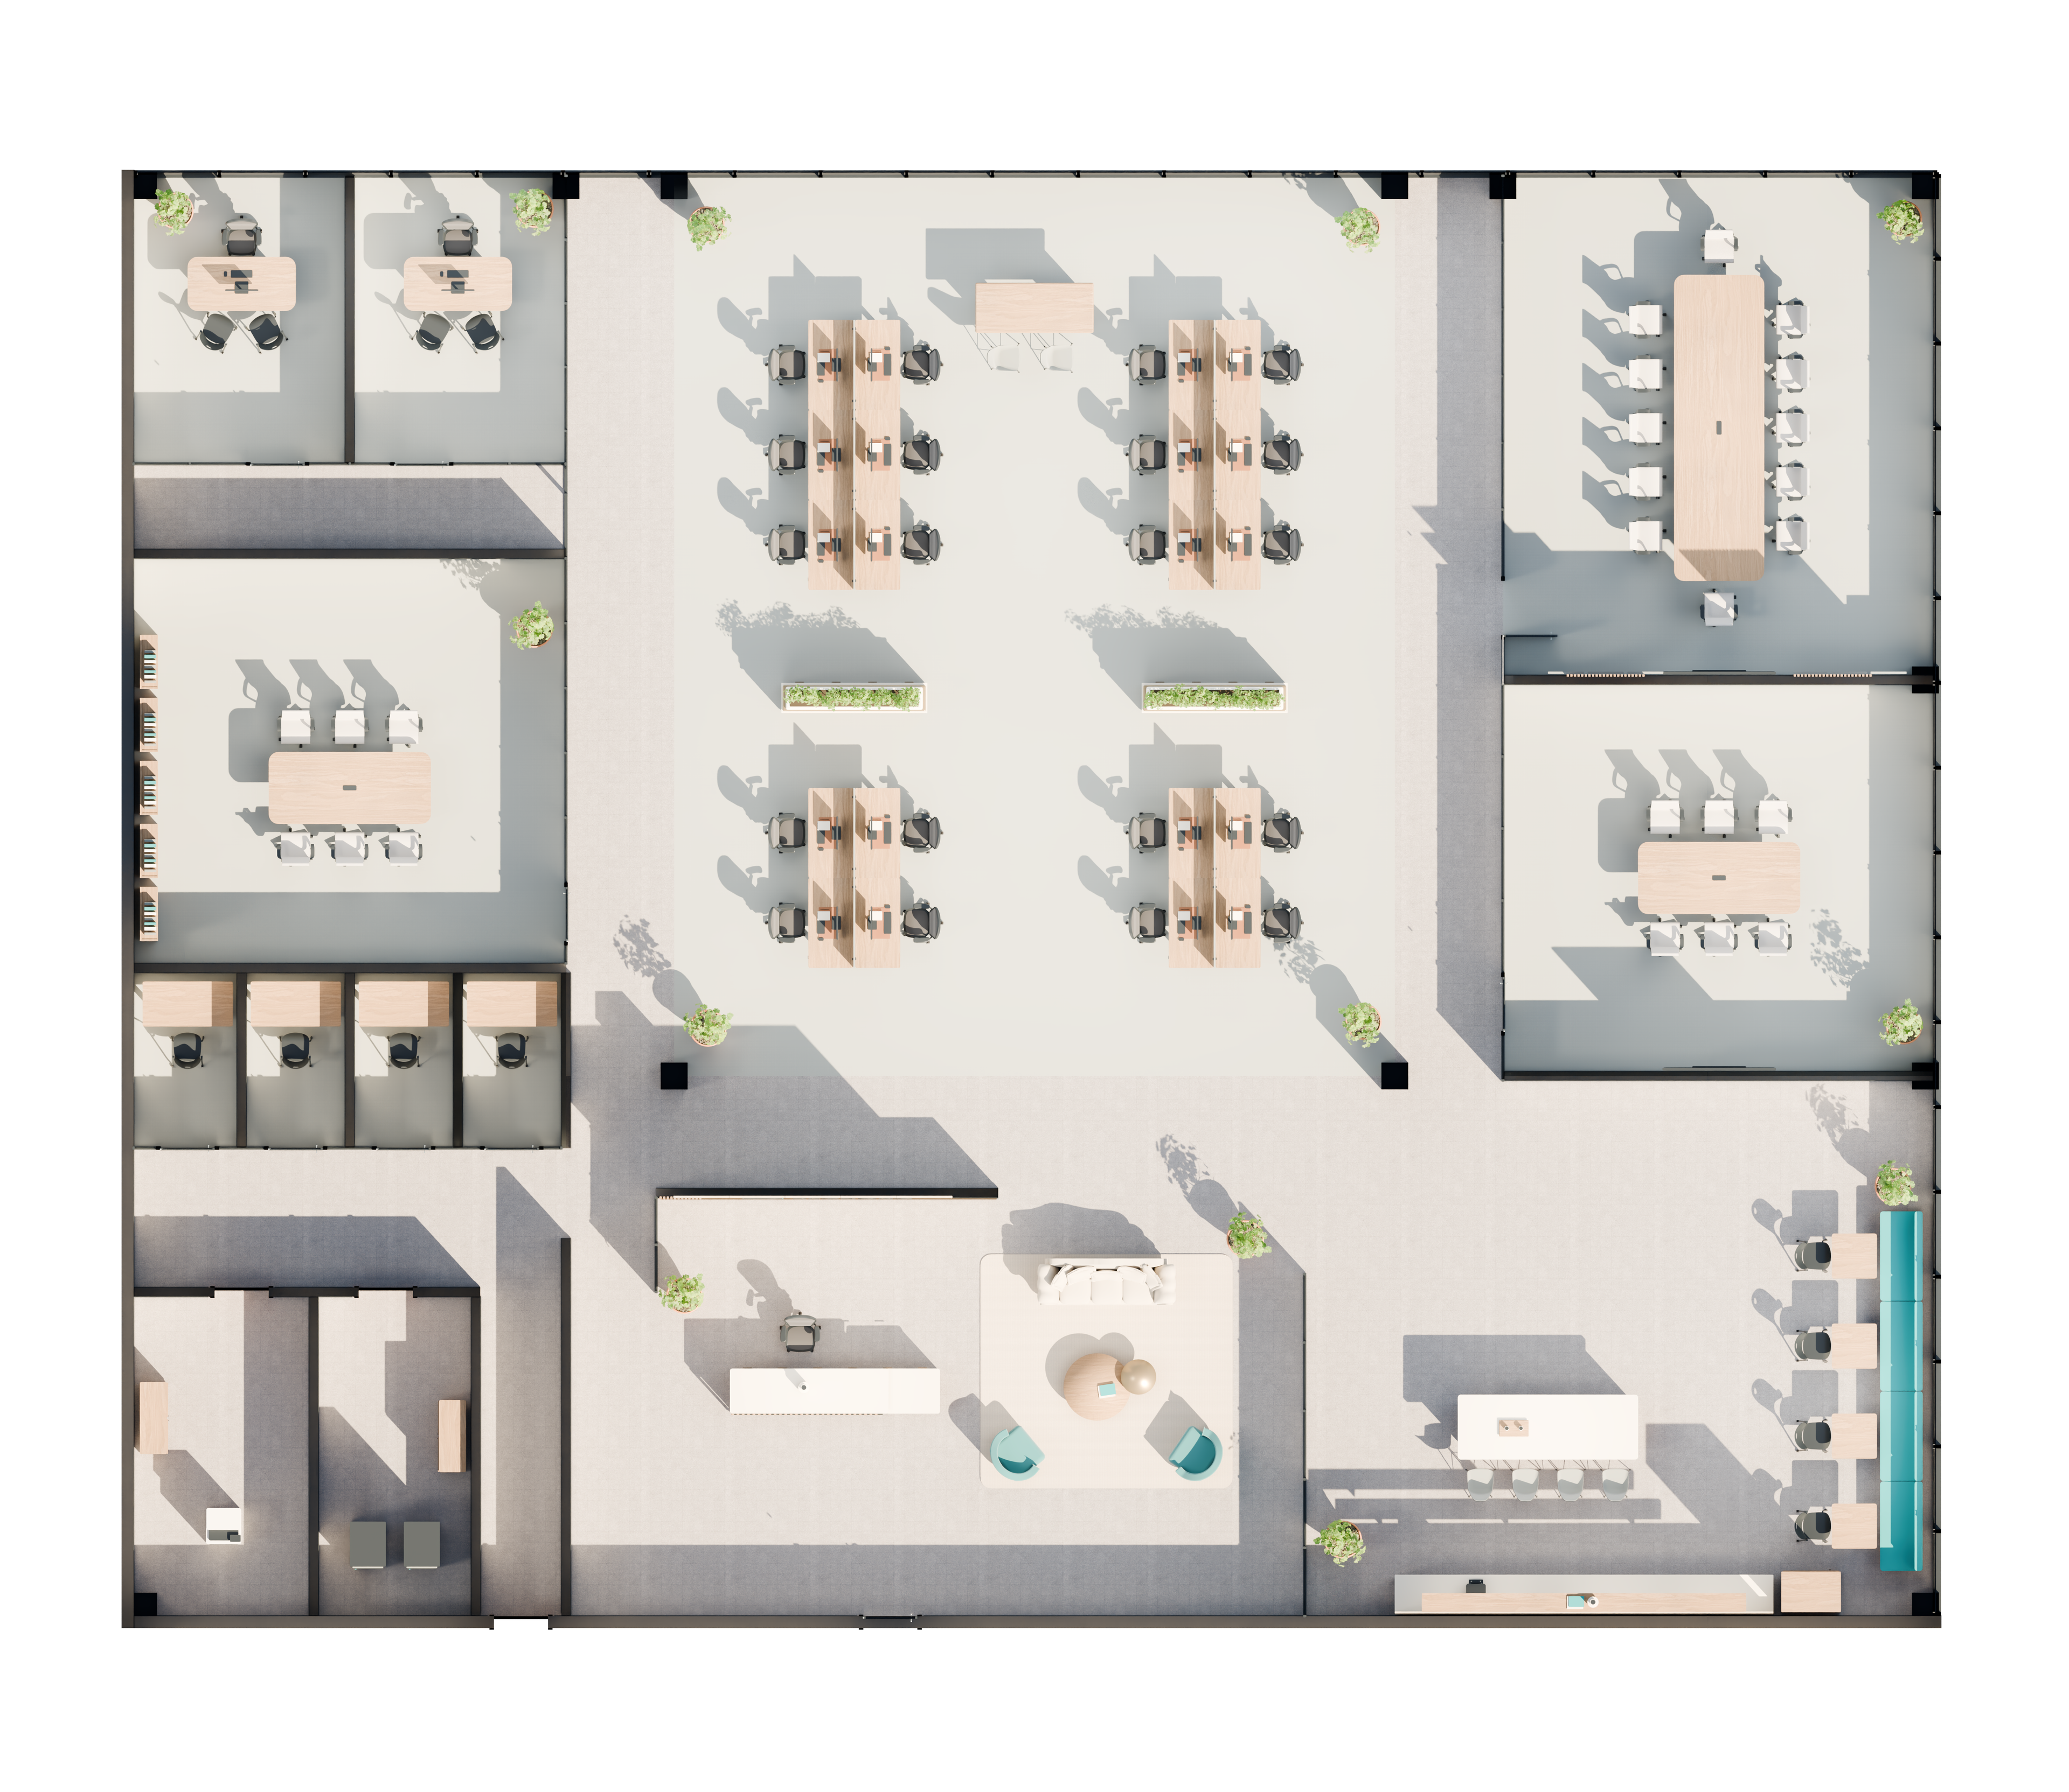
PLANORA / MIAMI OFFICE
Space & Capacity
20 open workpoints + 2 private offices + 1 reception
12-seat boardroom · two 6-seat rooms · four focus rooms
Prepared by PLANORA · September 22, 2026
05

Slide 6
PLANORA / MIAMI OFFICE
Office Layout
A central studio with supporting spaces around it.
Reception and cafe define the arrival setting.
Prepared by PLANORA · September 22, 2026
06

Slide 7

PLANORA / MIAMI OFFICE
Design & Brand
Warm oak · mineral surfaces · charcoal frames
Existing PLANORA identity, expressed with restraint.
Prepared by PLANORA · September 22, 2026
07

Slide 8
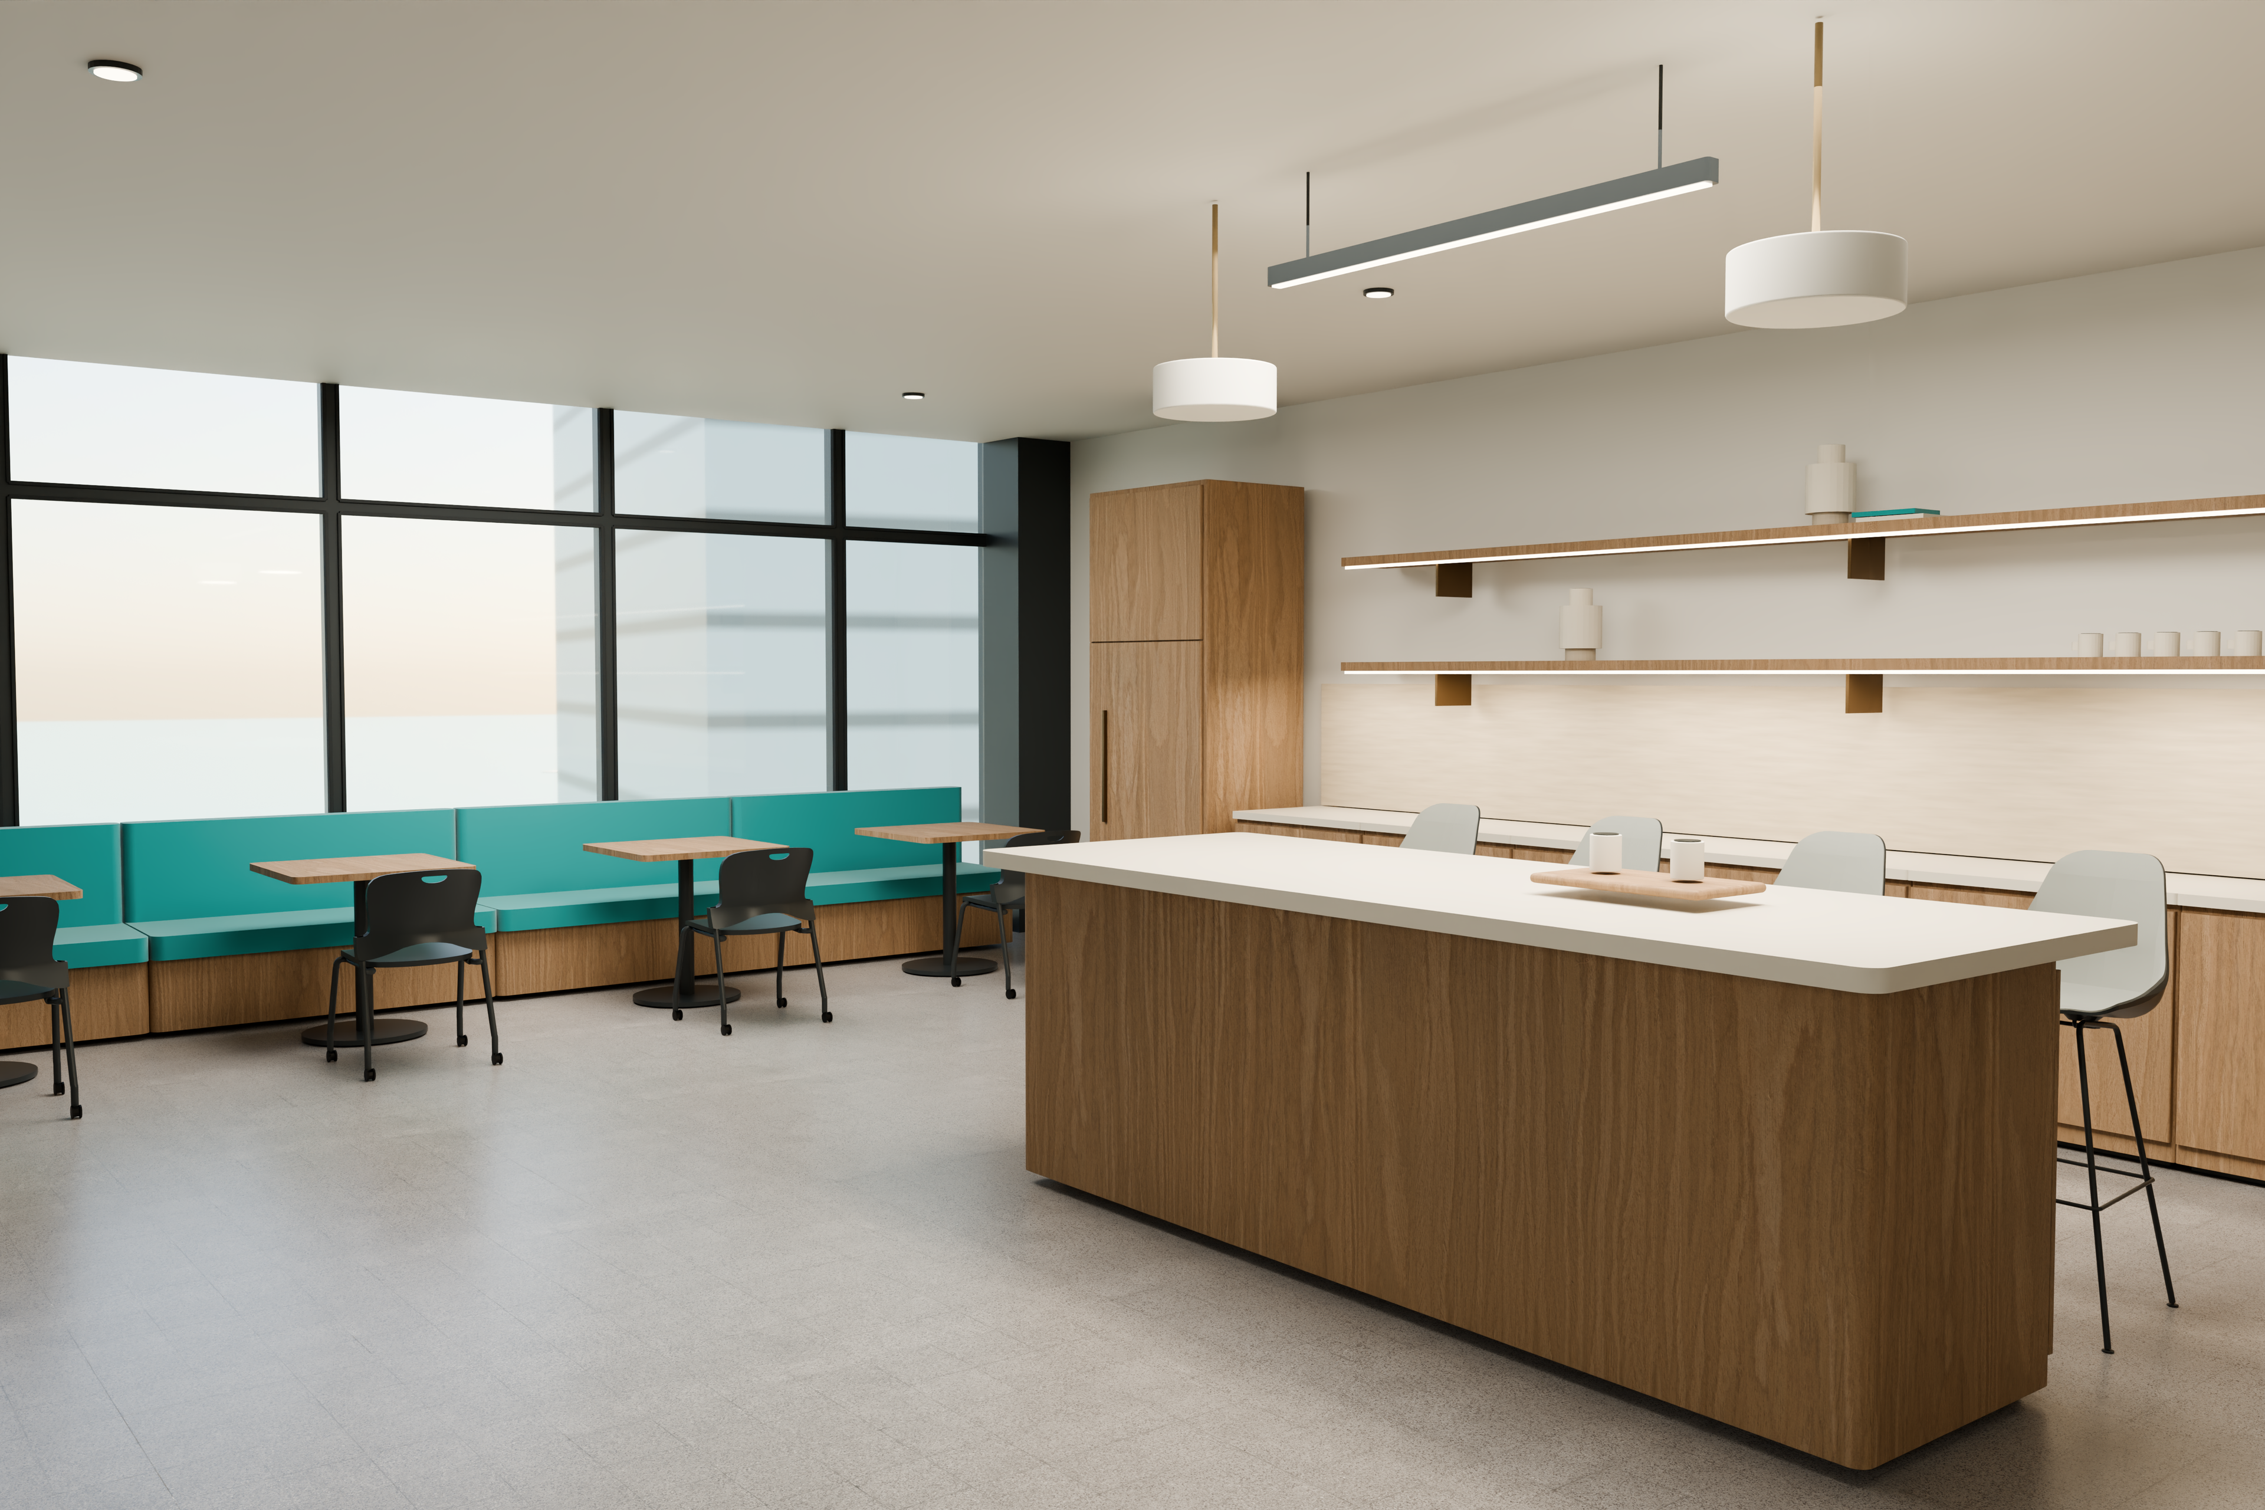
PLANORA / MIAMI OFFICE
Arrival & Hospitality
A confident welcome and a shared place to pause.
Prepared by PLANORA · September 22, 2026
08

Slide 9
PLANORA / MIAMI OFFICE
The Working Studio
Twenty open workstations form the core of the office.
Prepared by PLANORA · September 22, 2026
09

Slide 10

PLANORA / MIAMI OFFICE
A private setting for focused work
An enclosed office combines an assigned desk and visitor seating, with the Miami context beyond the facade.
Prepared by PLANORA · September 22, 2026
10

Slide 11

PLANORA / MIAMI OFFICE
A place to develop ideas
Six shared seats support project discussions in an enclosed room, separate from the working studio.
Prepared by PLANORA · September 22, 2026
11

Slide 12

PLANORA / MIAMI OFFICE
The Boardroom
Twelve seats around a shared table.
Prepared by PLANORA · September 22, 2026
12

Slide 13
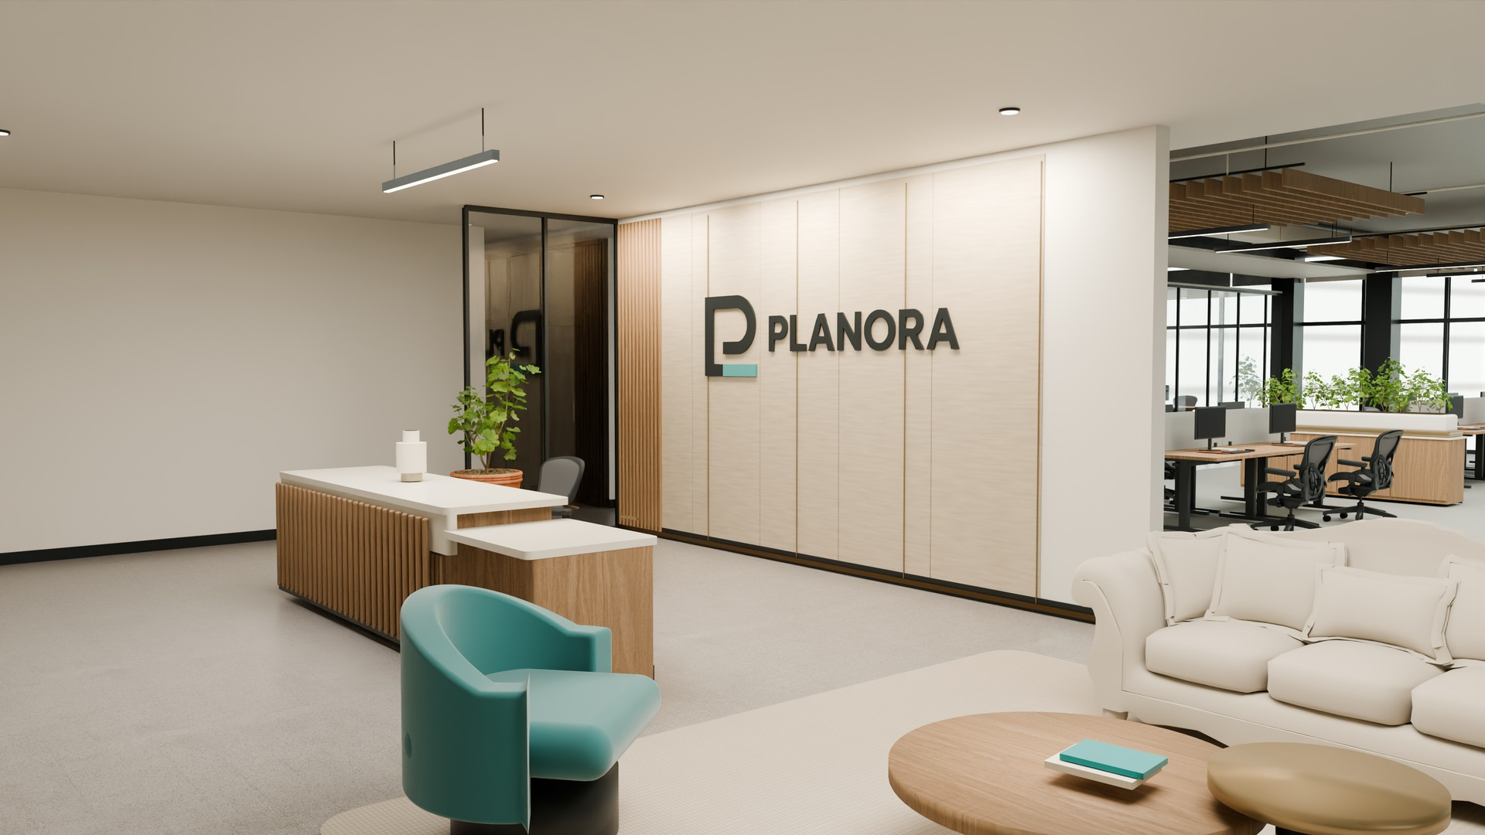
PLANORA / MIAMI OFFICE
Office Film & 3D Portal
Play the embedded 60-second film in PowerPoint slide show.
For the rotatable 3D model, open the delivery portal. PDF: use Office Film.mp4 or the portal.
Prepared by PLANORA · September 22, 2026
13

Slide 14
PLANORA / Miami Office
Requirements & Fit
The demonstration brief fits the concept floor. Confirm the real operating conditions before commitment.
REQUIREMENT
DESIGN RESPONSE
VERIFY
NEXT STEP
Day-one assigned capacity
22 staff workpoints + 1 reception position
Operating headcount and attendance are synthetic assumptions.
Confirm the actual team and peak attendance.
Shared meeting settings
12-seat boardroom; two 6-seat rooms
Meeting demand and visitor peaks are not observed.
Test booking demand and visitor circulation.
Individual concentration
2 private offices; 4 focus rooms
Spatial enclosure is shown; acoustic performance is untested.
Set privacy targets and verify partition assemblies.
3-year demonstration horizon
22 staff workpoints retained; no growth desks reserved
Stable attendance is assumed only for this demonstration.
Confirm growth targets before fixing the scope.
One spatial proposal. Shared meeting seats are not additional assigned workpoints.
Prepared by PLANORA · September 22, 2026
14

Slide 15
PLANORA / MIAMI OFFICE
Investment Outlook
Lower
Base
Upper
$1.45m
$1.74m
$2.27m
$1.45m favorable · $1.74m base · $2.27m restrictive
Owner-side conceptual budget · scenarios are sensitivities, not guaranteed limits.
Conceptual implementation investment
Estimated rates and provisions; no project quotations.
The visual presentation reflects the campaign revision. The budget (D02) and implementation schedule (R02) are retained as technical references and do not fully incorporate these visualization changes.
Prepared by PLANORA · September 22, 2026
15

Slide 16
PLANORA / Miami Office
Implementation Timeline
~36.9 weeks overall · ~21.8 weeks on site, included in total
Survey, design & application
Weeks 1–14
Review & purchasing
Weeks 10–20
Manufacturing & deliveries
Weeks 15–34
Field work & inspections
Weeks 24–36
Final approvals & acceptance
Weeks 34–37
Scope → coordinated design → reviews / purchasing → released work → final approvals
Illustrative dates; overlapping activities. Open Office Schedule.mpp for task dependencies and Office Schedule.pdf for the Gantt. Scenario assumptions: Schedule Basis.md.
Prepared by PLANORA · September 22, 2026
16

Slide 17
PLANORA / MIAMI OFFICE
Key Considerations
01 Premises + brief
02 Technical validation
03 Quotations + delivery inputs
Confirm premises and operating brief.
Validate technical capacity. Replace allowances with quotations.
Prepared by PLANORA · September 22, 2026
17

Slide 18
PLANORA / MIAMI OFFICE
Next Steps
Confirm the premises and operating brief before technical development.
Conceptual demonstration · Not for construction
Prepared by PLANORA · September 22, 2026
18

